Slide 1
Real Time Collaboration on Building Models
Submitted by :
Anjana Muraleedharan Nair Matriculation Number: 125512
Prasamsa Nandanan Matriculation Number: 125288
Selva Ganapathy Elangovan Matriculation Number: 124769
Vishal Sanjay Shivam Matriculation Number: 125353

Slide 2
AGENDA
Introduction
Problem Statement
Objective
Methodology
Implementation
Challenges Faced
Future Direction
Conclusion

Slide 3
FLOW CHART
Identifying Project Objectives
Literature Research
System Architecture Design and Implementing Software Components
System Testing and Monitoring System Performance
Documentation and Report Writing

Slide 4
Application Scenario
Remote Collaboration Optimization
Facility Management Efficiency
Renovation Project Coordination

Slide 5
INTRODUCTION - OVERVIEW OF THE PROJECT
The project aims to develop a comprehensive solution for automating data updating and distribution across multiple systems in real time.
Key Components:
RDF (Resource Description Framework)
IFC (Industry Foundation Classes)
SPARQL queries
XML Serialization
TCP listeners

Slide 6
PROBLEM STATEMENT
Building Information Modelling (BIM) technology has advanced significantly, but real-time updating of Industry Foundation Classes (IFC) files from Revit still poses challenges.
Conventional methods lack automatic synchronization between Revit and IFC files.
This deficiency leads to inefficiencies in data exchange and collaboration among project stakeholders.

Slide 7
OBJECTIVES
Automated real-time updates: Develop a solution to automatically update the IFC files in Revit in real-time when the modifications are done to the Revit model.
Enhance data manipulation: Implement functionalities using XBIM library efficiently manipulate BIM entities within the REVIT model.
Efficient communication infrastructure: Develop a robust communication infrastructure utilizing TCP Listener to facilitate data exchange between the REVIT model and external systems.

Slide 8
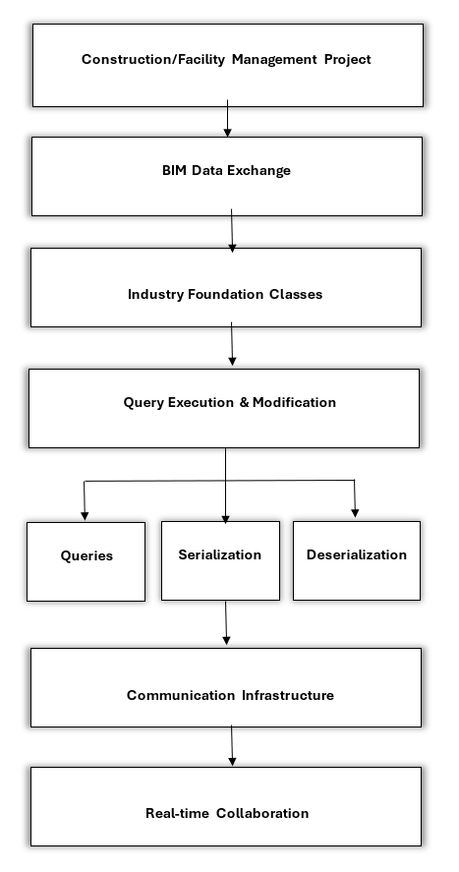
METHODOLOGY
Automated Data Updating: Streamline process.
Queries for Modification: Targeted adjustments.
Serialization & Deserialization: Enhance exchange.
Real-Time Collaboration: Robust infrastructure.
Efficiency & Accuracy Boost: Reliable solution.

Slide 9
TCP Communication Process
TCP ensures reliable and connection-oriented communication between devices over IP-based networks.
Serialized XML data is transmitted from System1 to System2 .
System1 acts as the TCP Client and System2 acts as the TCP server
System2 updates the RDF database
Acknowledges the target systems.

Slide 10
USE CASES
Modify the name of an existing wall.
Set the name of a newly created wall.
Add owner history information to an existing wall entity.
Add Property set and associated properties to an existing wall entity within the building model.

Slide 11
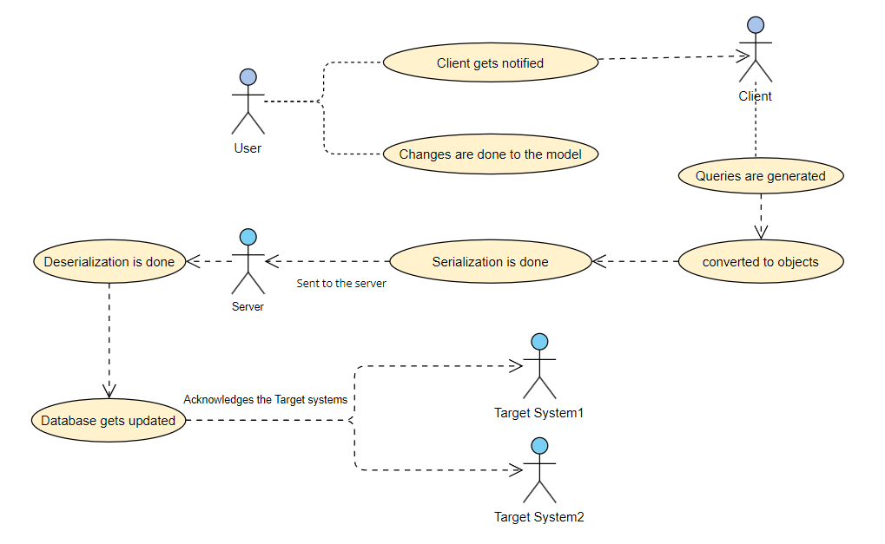
USE CASE DIAGRAM

Slide 12
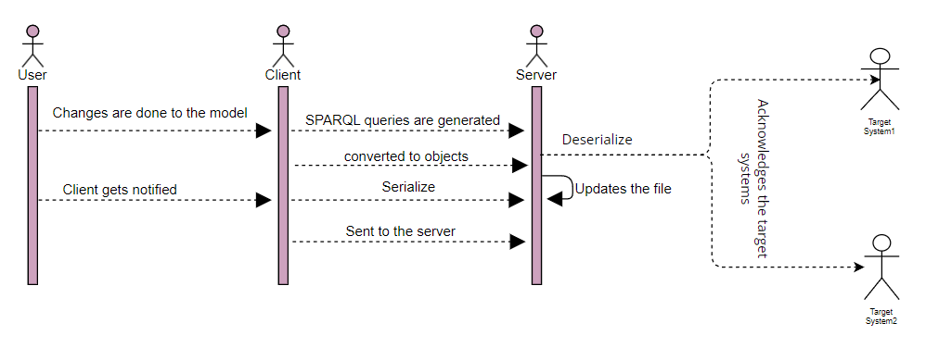
SEQUENCE DIAGRAM

Slide 13
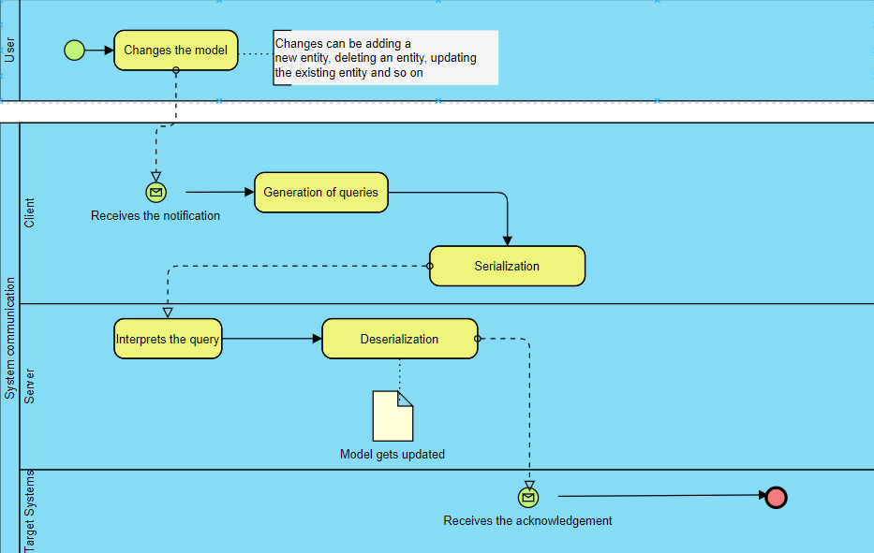
BPMN
Notes:
starting with a Start Event indicated by a green circle-action of the user to change a model, the notification is communicated to the client through a Message Flow, dashed lines. This signals that the client, a separate organizational entity within the diagram, has become active in the process.
generation of queries takes place-connected by Sequence Flows – solid lines with arrowheads.
The process concludes with an End Event in the Server, a red circle with a thick border, representing the server sending an acknowledgment to the target systems.
The BPMN diagram thus facilitates a clear visualization of the communication and operational sequence between the user, client, and server, ensuring that the changes to the model are executed efficiently.

Slide 14
IMPLEMENTATION
Generated SPARQL queries.
Serialization and sending to the server
Deserialization and updation of RDF data.
Acknowledges target clients.
Notes:
RDF-standard model for representing data on the web, particularly in the form of triples: subject-predicate-object statements.
To store RDF data, various serialization formats are used, including Turtle, RDF/XML, and N-Triples. These formats provide different ways to represent the same RDF graph.
FileLoader.Load method is utilized to parse RDF data files and extract triples from them. These triples are then organized and stored in a Triple Store object, which acts as a repository for RDF triples, enabling efficient storage and manipulation of RDF data within the program.
SPARQL-query language used to manipulate RDF data. SPARQL update queries are dynamically constructed using string interpolation . This feature allows the seamless inclusion of expressions or variables into string literals, enabling the creation of customized queries.
Used for specific operations, such as renaming walls etc. Placeholder values within the SPARQL query template are replaced with actual values derived from method parameters, variables, or constants during execution. This dynamic query generation enhances the program's versatility and efficacy in manipulating RDF data.
Serialization -SPARQL update queries, along with associated metadata, into a structured format suitable for transmission over the network. In the program, XML is chosen as the serialization format due to its widespread usage for representing structured data.
Initially, SPARQL update queries are encapsulated within XElement objects, which capture both the query content and metadata. These XElement objects are then converted into strings during serialization, preserving the structure and content of the queries in a standardized manner. This transformation ensures that the resulting XML representation reflects the structure of the queries, facilitating storage or transmission over the network.
The SendSerializedXmlToSystem2 method facilitates the transmission of serialized XML data over a TCP/IP connection to another system, referred to as the RDF Processing System. This method establishes communication with the RDF Processing System by specifying its IP address and port number.
Prior to transmission, the XML data representing SPARQL update queries is serialized into a string format using UTF-8 encoding. Subsequently, a network stream is obtained from the TcpClient object, serving as the conduit for transmitting data across the TCP connection. The serialized XML data is then written to the network stream as a byte array using the Write method, facilitating data transmission to the RDF Processing System. Finally, the TCP connection is gracefully closed using the Close method upon completion of data transmission.

Slide 15
CHALLENGES FACED
Initial Attempt with BIM Server
Trouble with Apache Jena Server and Updating IFC File
Discovering the Need to Convert IFC to RDF
Challenges with SPARQL Query Generation
Difficulty in Deserializing XML Object and Updating Turtle File

Slide 16
LIMITATIONS
Scalability
Technical Expertise Requirements
Implementation and Validation
Security and Privacy issues

Slide 17
CONCLUSION
Developed a comprehensive solution for real-time collaboration and synchronization between Revit models and IFC files.
Utilized RDF, IFC, SPARQL queries, XML Serialization, and TCP listeners to enable real-time data management.
Enabled standardized data representation and integration.
Notes:
dfgj

Slide 18
FUTURE DIRECTIONS
User action with Unity.
Updation of IFC file using different approaches.

Slide 19
THANK YOU

